Slide 1
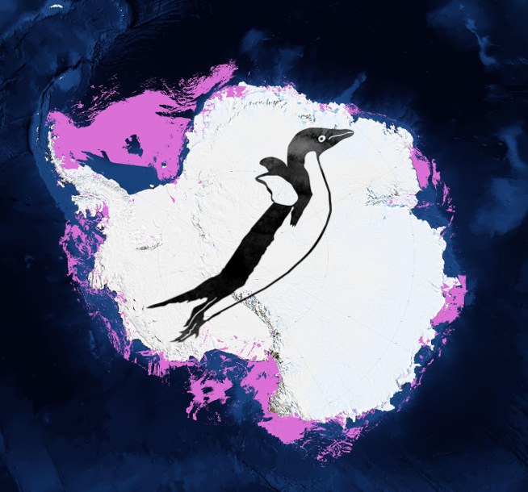
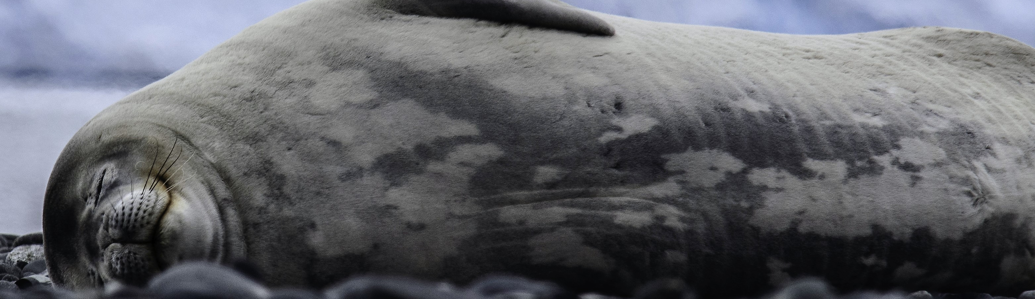
Seal Team 6
http://polar-computing.org

Slide 2
Science Objective
Identify individual Weddell seals
Construct a Weddell Seal image catalog
Understand movement of Weddell seals over time

Slide 3
Seal image catalog
Image 1
Many possible algorithms ➣ Consensus-based approach
Image 2
✓
Seal 1
Match new image to the existing catalog to look for matches
Image 3
Image 4
Algorithm 1
Algorithm 2
Algorithm 3
Consensus
✗
…
Image 1 0.05
Image 2 0.07
Image 3 0.12
.
.
.
Image 1 0.15
Image 2 0.01
Image 3 0.02
.
.
.
Image 1 0.04
Image 2 0.17
Image 3 0.10
.
.
.
Image 1 0.09
Image 2 0.23
Image 3 0.08
.
.
.
Image 10
Image 11
Seal 2
Image 12
Image 13
…

Slide 4
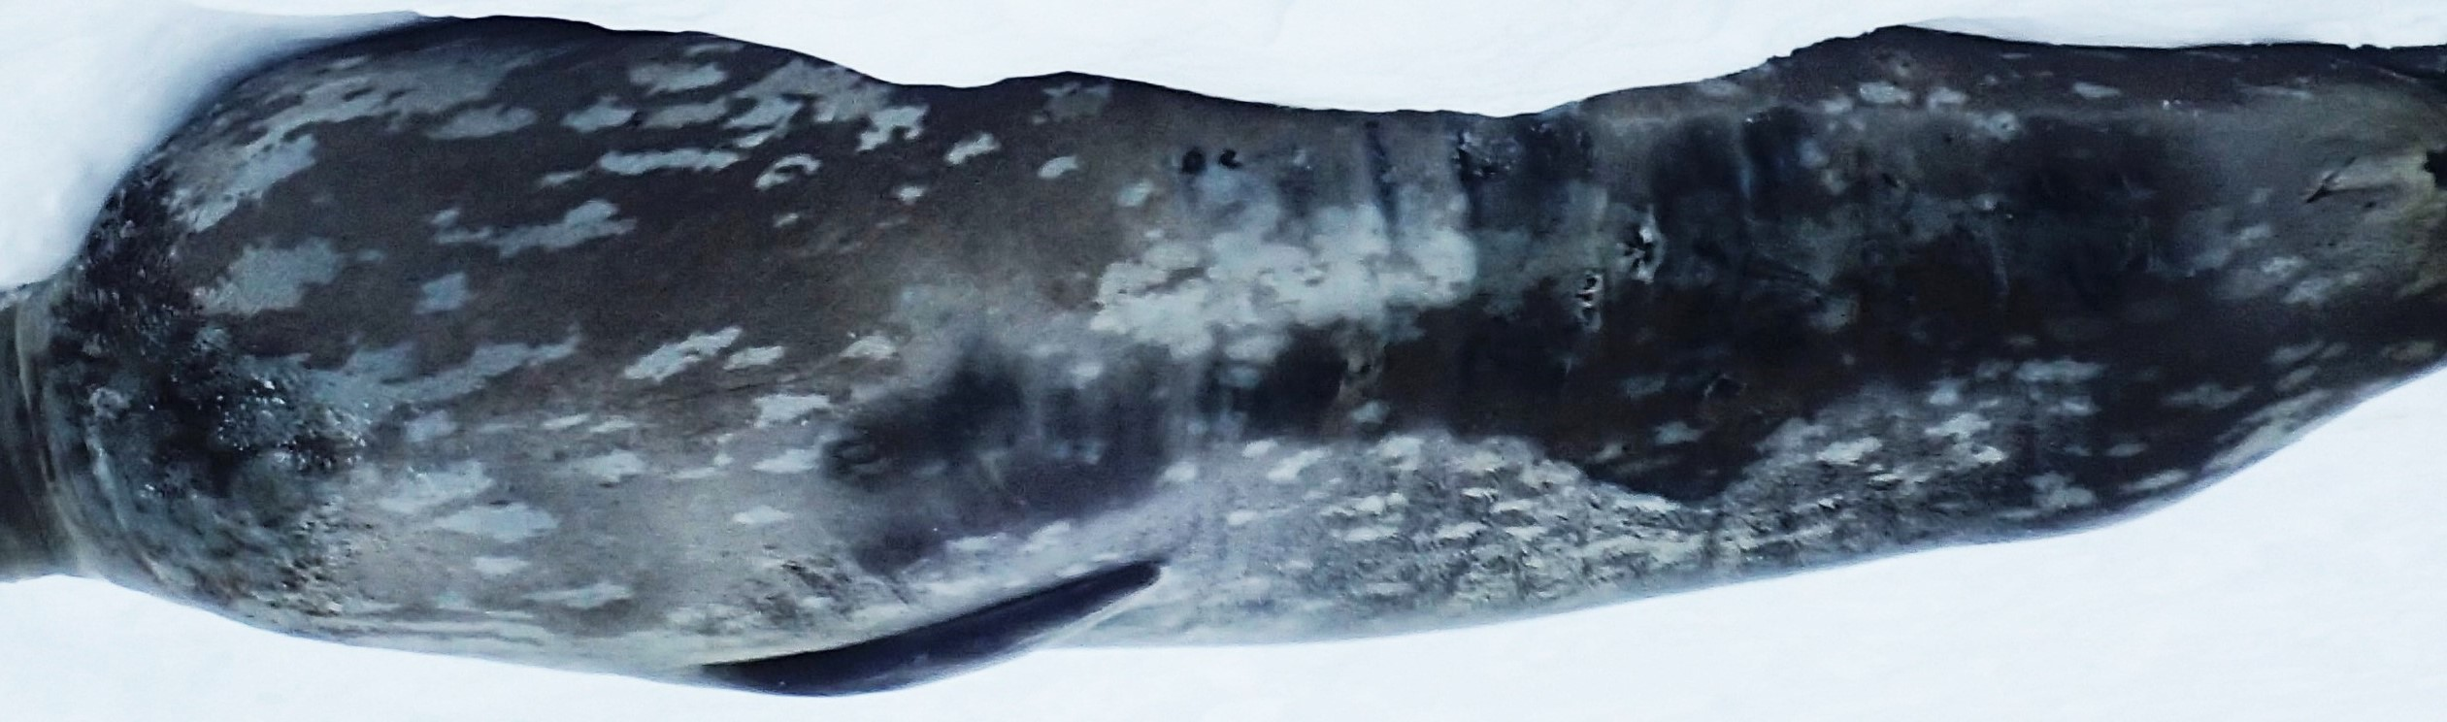
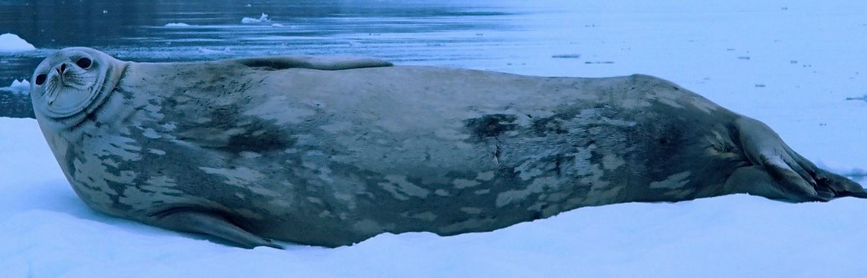
One possible algorithm…
‘Bag of patches’ model
(inspired by ‘bag-of-words’ modeling for text analysis)
Collection of patches 1
Some number of shared patches indicative of match
Collection of patches 2

Slide 5
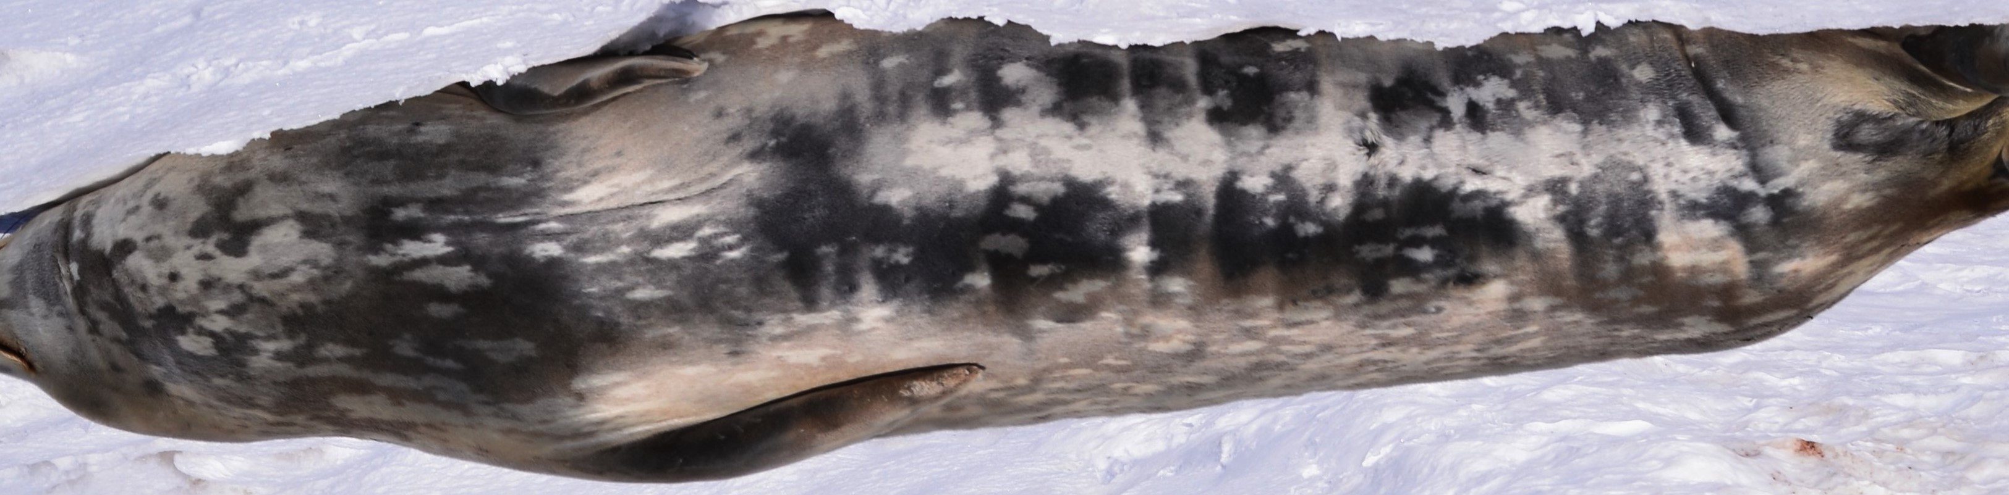
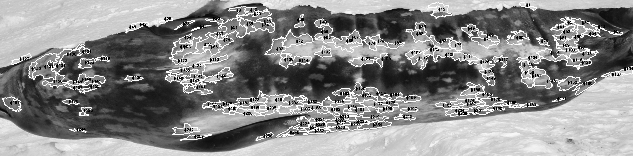
Basic workflow
Calculate maximum patch match
gamma correction
adaptive threshold
boundary
segment
and weight by patch complexity
Patch complexity metric inspired by
Grove et al. 2015

Slide 6
What did you not achieve?
Didn’t link to HPC yet, but identified areas where parallelization may speed the match process
No clear algorithm for creating a consensus given multiple algorithms

Slide 7
Any highlights? What worked? What didn’t?
No major barriers, just requires more time

Slide 8
Biggest insight/lesson learnt?
By Scientists?
Considerably more complicated than anticipated (which is probably why the existing tools for pattern matching don’t work that well for seals)
By programmers?
Quickly working towards an initial visual prototype that everyone can run is great first step that increases team motivation
Python as rapid-prototyping language and the OpenCV library works very well
Splitting into smaller teams and working in parallel for feature implementation works well
High throughput computing tools could be used to take advantage of low-barrier entry to HPC
Defining the scope of desired features is hard for a project in its initial stages
Difficult to mitigate feature creep once initial results look good
Difficult to stop trying to perfect a feature when results are not as good as expected

